Slide 1

CS 3600 Project FIFA ’18 by EA Sports
By: kishan polekar

Slide 2


Introduction
Around 211 countries are a part of the FIFA.
32 countries qualified for the 2018 world cup.
Data was extracted from the FIFA 2018 game developed by EA.
Main data file (“CompleteDataset.csv”) taken from Kaggle.
17,981 observations and 75 attributes.
Main attributes: Age, Nationality, Club, Overall performance, Club Value, Primary position.

Slide 3
Analysis of Data
Using r and its libraries

Slide 4
Libraries Used
ggplot2 : Plotting graphs, histograms, and points.
dplyr : Selecting particular data, filtering data, etc.
gridExtra : additional grid functionality

Slide 5
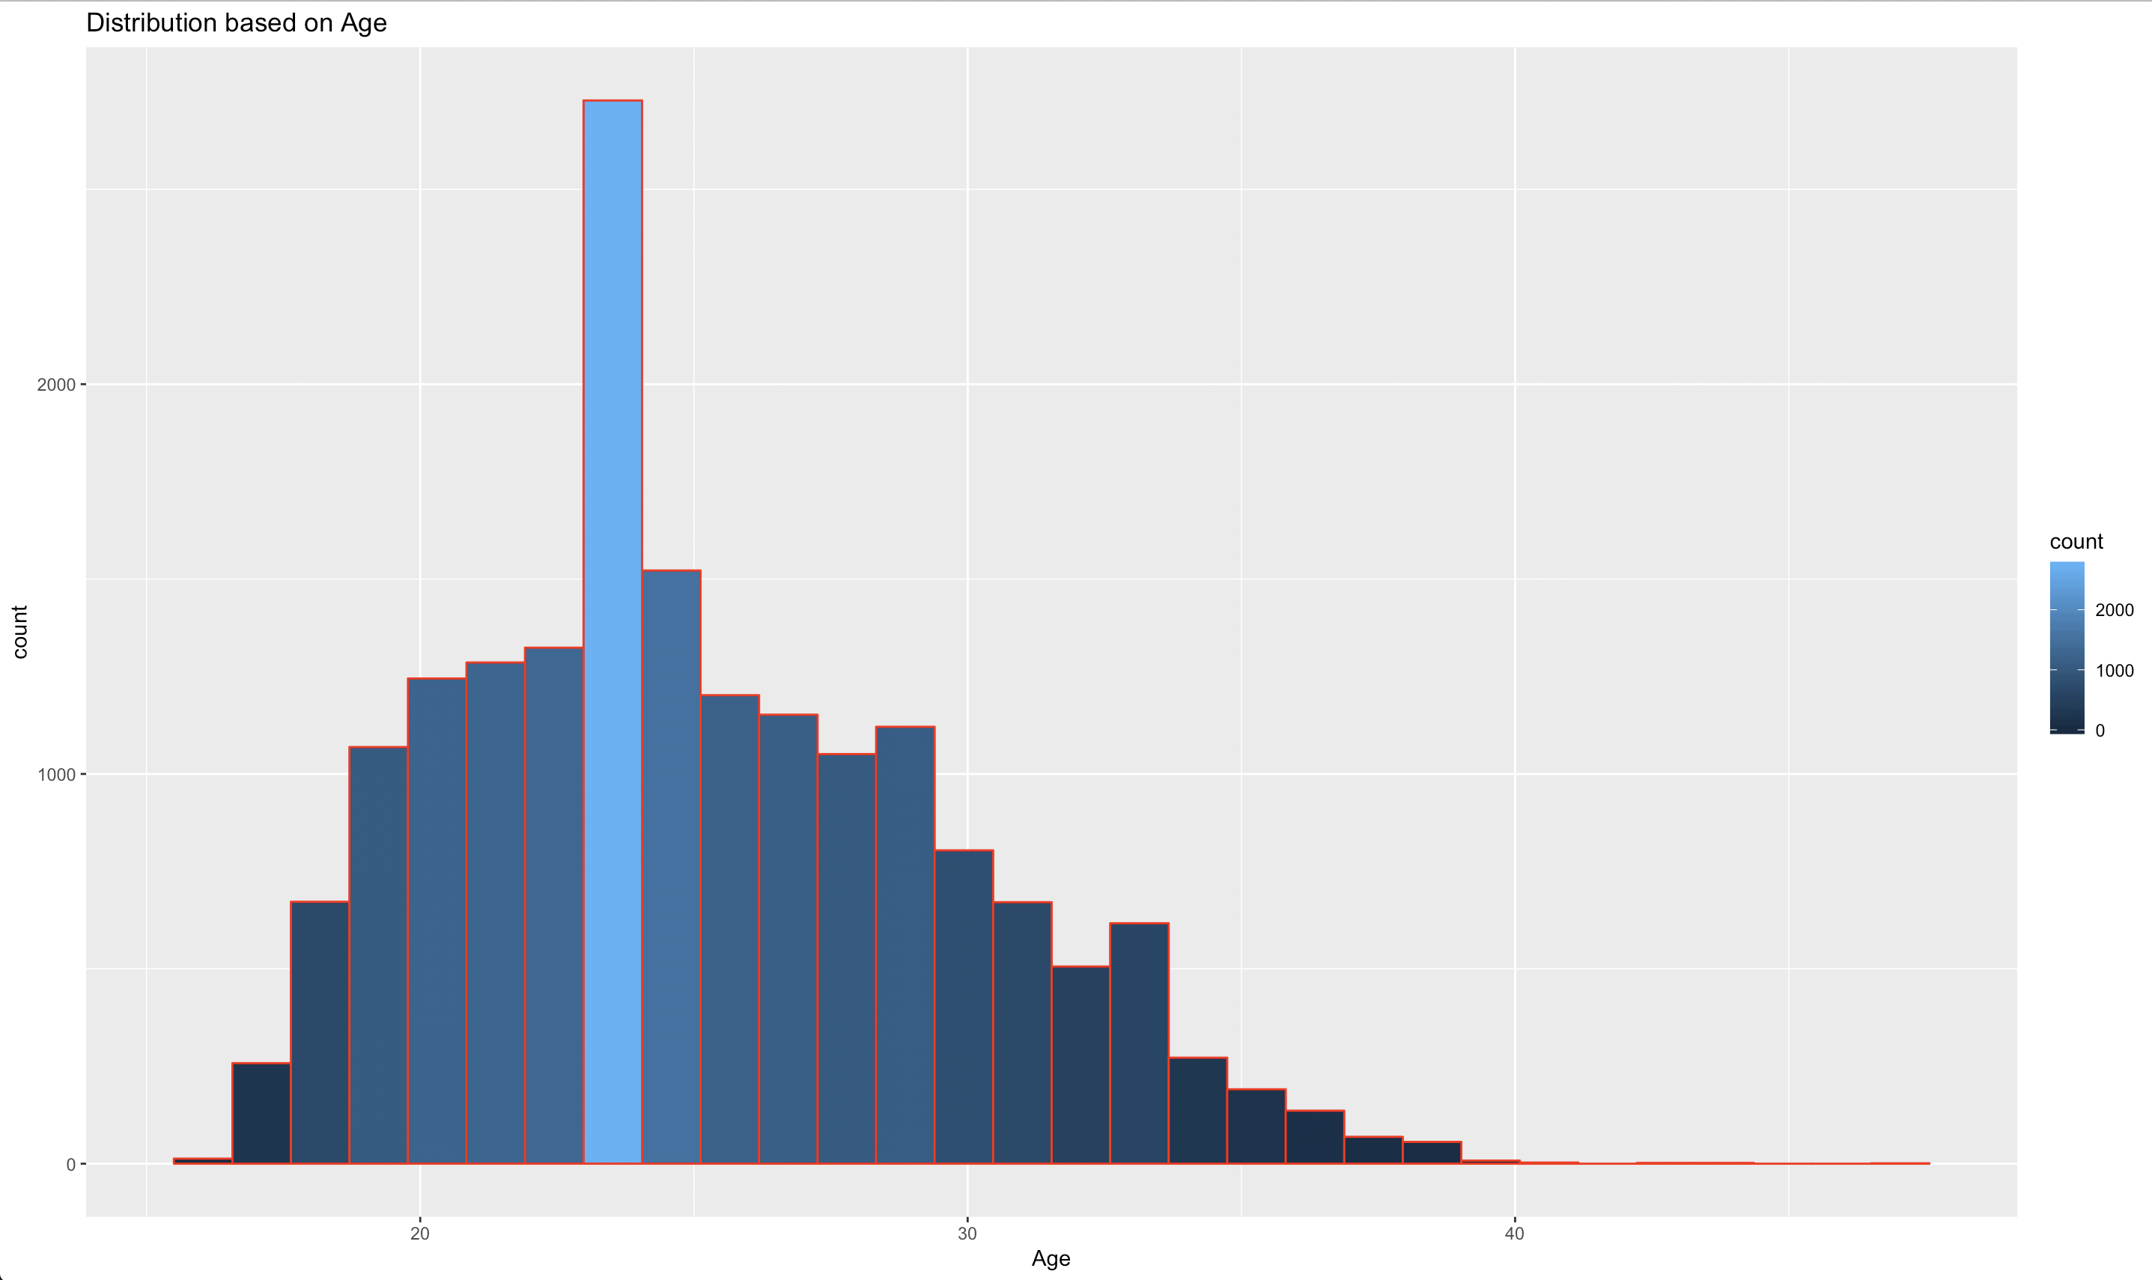
Age Distribution

Slide 6

Analysis and Source Code
Most players are around 23 years of age.
Age is concentrated in the 20-30 years range.
There are players who are teenagers and there are players who are around 50 years of age.

Slide 7
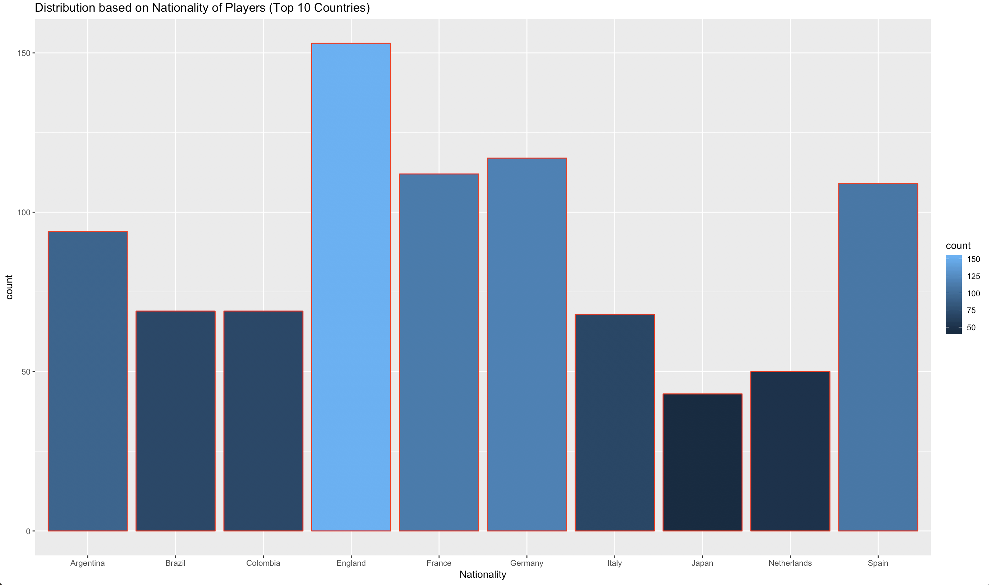
Nationality Distribution

Slide 8
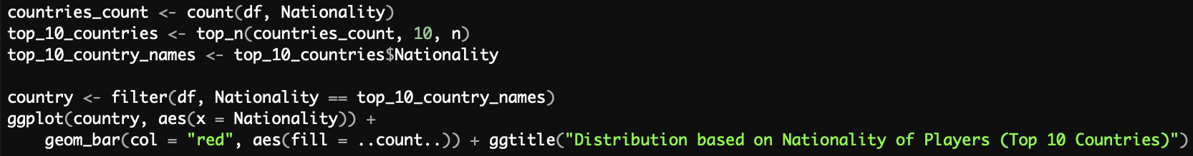
Analysis and Source Code
England has the most number of players in the game.
Top three countries: England, Germany, France.

Slide 9
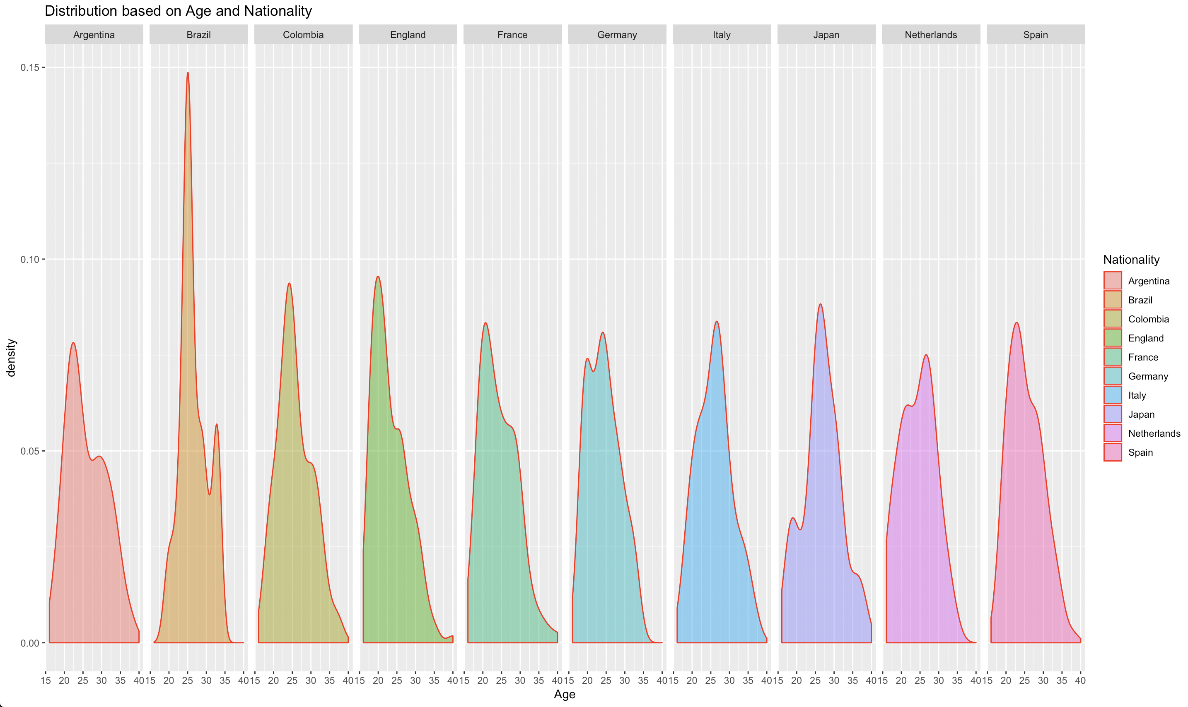
Age Distribution based on Country (Top 10)

Slide 10

Analysis and Source Code
Brazil has most of their players young as compared to other countries.
Least number of old players (>35) : England
Most number of old players (>35) : Japan

Slide 11
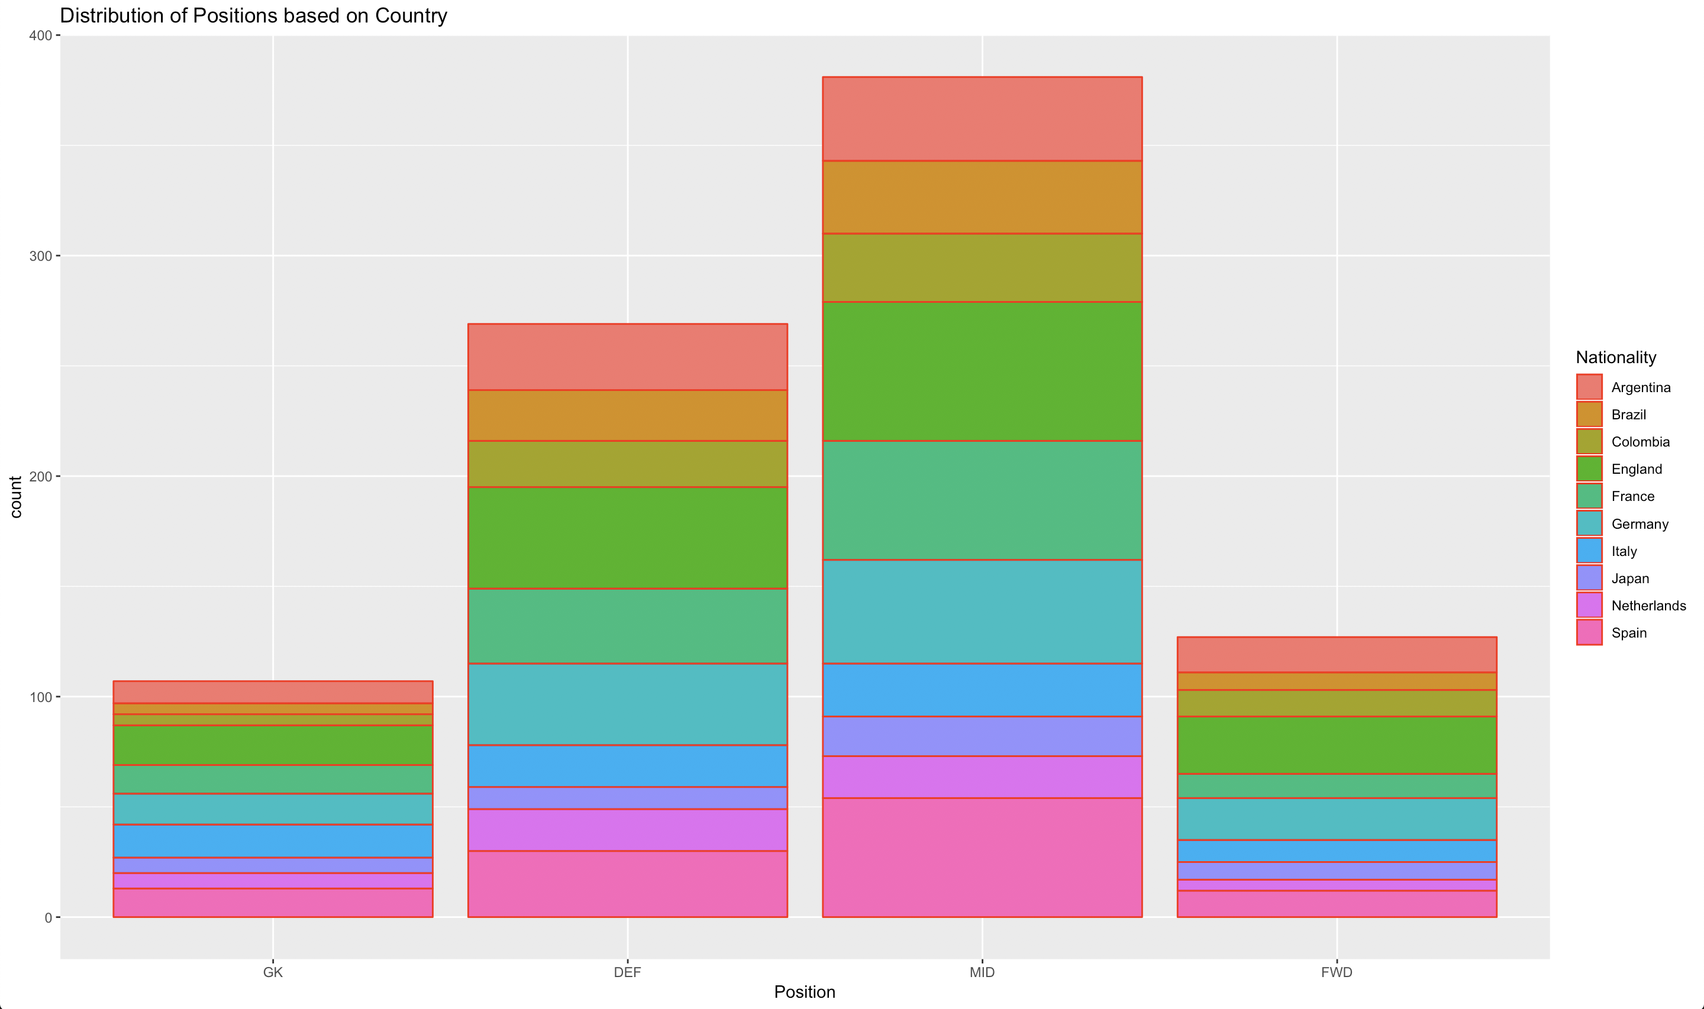
Positions based on Country (Top 10)

Slide 12
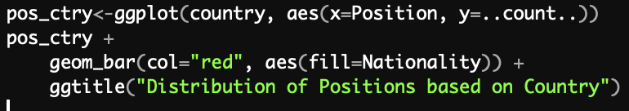
Analysis and Source Code
Most players are midfielders; least are goalkeepers.
England has the most mids, defenders, as well as most forwards.
Close competition given by France and Spain.

Slide 13
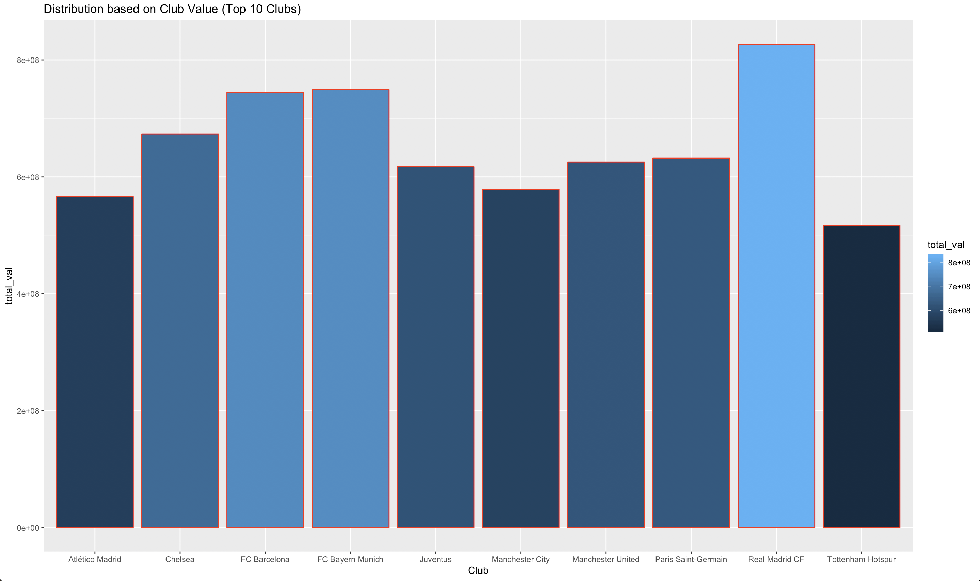
Top 10 Clubs by Total Club Value

Slide 14
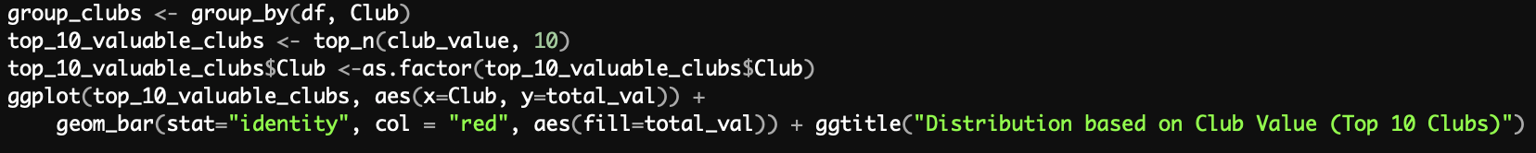
Analysis and Source Code
Real Madrid FC (Spain) is the richest club.
FC Bayern Munich (Germany) and FC Barcelona (Spain) are very close. They are second and third respectively.
Club value depends upon the players it has, their ratings, and club fan following.

Slide 15
References
https://sofifa.com
https://www.kaggle.com/thec03u5/fifa-18-demo-player-dataset
https://towardsdatascience.com/exploratory-analysis-of-fifa-18-dataset-using-r-ba09aa4a2d3c

Slide 16
Thank You

